Slide 1
An Efficient Technique for Exploring Storage Organization in ASIP Synthesis
Manoj Kumar Jain
Prof. M. Balakrishnan and Prof. Anshul Kumar
Department of Computer Science & Engineering
IIT Delhi
http://www.cse.iitd.ernet.in/esproject
Synopsis presentation, Jan. 2003

Slide 2
Outline
Introduction and Motivation
Overall Objectives
Methodology
Estimating Execution Time with Limited Regs.
Overheads due to Limited Reg. Windows and Cache Misses
Results and Validation
Conclusions

Slide 3
GPP-ASIP-ASIC
ASIPs (Application Specific Instruction Set Processors)
Designed for specific application
Exploits special characteristics to meet the desired constraints
Efficient for applications like digital signal processing, automatic control systems, cellular phones etc.
 | GPP | ASIP | ASIC
Performance | Low | High | Very High
Flexibility | Excellent | Good | Poor
HW Design Effort | Nil | Large | Very Large
SW Design Effort | Small | Large | Nil
Power | Large | Medium | Small
Reuse | Excellent | Good | Poor
Markets | Very Large | Relatively large | Small
Cost | Mainly on SW | S-O-C | Volume sensitive

Slide 4
Flow Diagram of ASIP Design Methodology
Application &
Design Constraints
Application Analysis
Architectural Design Space Exploration
Instruction Set
Generation
Code Synthesis
Hardware Synthesis
Object Code
Processor Description

Slide 5
Approaches in ASIP Design Space Exploration
Efficient retargetable compiler and simulator required
Slower
More accurate
More architectural features have been explored
Application
(C)
Retargetable
Compiler
Object
Code
Retargetable
Simulator
Simulator based
Architecture
Description
Trace Data
No target specific code generation
Faster
Less accurate
Less architectural features have been explored
Application
(C)
Architecture
Description
Profiler
Retargetable
Estimator
Scheduler based
Performance and
other Estimates

Slide 6
Register Size Evaluation: Motivating Study
Study the impact of changing the number of
registers on
Performance (# cycles), Power, Energy and Code size
Experimental Framework
Wehmeyer/ Jain TCAD 2001
C Code
encc
assembly
Assembler &
Linker
executable
energy
database
profiling
information
trace
analyzer
trace file
ISS

Slide 7
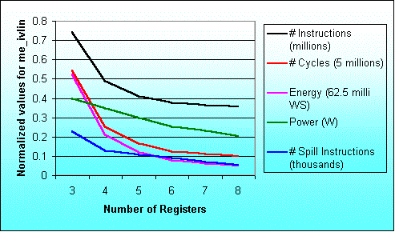
Result for the program me_ivlin
knee due to exec. time reduction
knee due to power saving

Slide 8
Overall Objectives
Fast design space exploration to explore increasing design space
Storage organization to be explored by scheduler based approach
Exploring register file size, register windows and cache configuration

Slide 9
Storage Exploration Methodology
Compute #window
Spills and Retores
Application + Per. Constraints
Cache simulator
Parameterized
Processor
Register allocation using RRCs
Scheduling
Parameterized
Memory
Execution time estimate
et_{R}
Overhead due to
window spills
oh_{W}
oh_{C}
Overhead due to
cache misses
Overall Execution time est.
ET
Storage configuration selector
ET = et_{R} + oh_{W} + oh_{C}

Slide 10
Methodology contd.
ET = et_{R} + oh_{W} + oh_{C}
Where
ET : Total application execution time
et_{R} : Execution time when reg. file contains R regs.
oh_{W} : Additional overhead due to window spills
oh_{C} : Additional overhead due to cache misses
et_{R} = bet + oh_{dep} + spill_{R} * t_{R}
bet : Base execution time (without storage constraints)
oh_{dep} : Overhead due to additional dependencies
spill_{R} : Number of register spills
t_{R} : Delay associated with each register spill
oh_{W} : spill_{W} * t_{W}
spill_{W} is number of window spills t_{W} is delay /window spill
oh_{C} = miss_{C} * t_{C}
miss_{C} is number of cache misses t_{C} is cache miss penalty

Slide 11
Exec. Time Estimates with Limited Registers: Methodology
[CASES 2002]
Application
Profiling
Processor description
SUIF
Profile information
SUIF IR
Dependence analysis
Control flow graph
Data flow graph
Local register allocation
using reuse chains
Estimate overhead to
handle global needs
For each Basic Block
Modified data flow graph
Local execution time estimate
Schedule overhead
due to global needs
Scheduling
For each function
Schedule estimate of single
execution of the basic block
Execution time estimates

Slide 12
Register Allocation using Register Reuse Chains
A Register Reuse Chain or RRC contains
all the variables assigned to the same register
Generating Initial Chains [Zhang 99]
Converting Initial Chains into dependence conservative chains [Zhang 99]
Computing merging costs (Our contribution)
Efficiently merging chains (Our Contribution)

Slide 13
Illustrative Example
l_2
a
load a;
b=2*a;
c=a+3;
d=a-4;
e=c*d;
f=c-d;
g=e/f;
h=g+5;
i=h*6;
j=h+7;
k=i/j;
l=b+k;
l_3
l_4
b
c
d
e
f
g
l_5
Source Code
h
l_6
l_7
Dependency Graph
l_x constant x loaded into reg
i
j
k
l

Slide 14
Generating Initial Reuse Chains
Earliest Ultimate Killing (EUK) Node is the earliest node where Variable’s live range is guaranteed to end
Earliest Ultimate Killing or EUK nodes are used to construct RRCs
Basic Idea Recursively search the EUK nodes and assign the same register.

Slide 15
Reuse Chains Formation
l_2
a
Variable EUK
a l
l_2 b
b l
l_3 c
c g
l_4 d
d g
e g
f g
g h
l_5 h
h k
l_6 i
i k
l_7 j
j k
k l
l l
l_3
l_4
b
c
d
Initial Chains
Chain 0 < a, l >
Chain 1 < l_2, b >
Chain 2 < l_3, c, g, h, k >
Chain 3 < l_4, d, i >
Chain 4 < l_5, j >
Chain 5 < l_6 >
Chain 6 < l_7 >
Chain 7 < e >
Chain 8 < f >
e
f
g
l_5
h
l_6
l_7
Dependency Graph
i
j
k
l

Slide 16
Reuse Chains Formation
l_2
a
Initial Chains
Chain 0 < a, l >
Chain 1 < l_2, b >
Chain 2 < l_3, c, g, h, k >
Chain 3 < l_4, d, i >
Chain 4 < l_5, j >
Chain 5 < l_6 >
Chain 6 < l_7 >
Chain 7 < e >
Chain 8 < f >
Variable EUK
a l
l_2 b
b l
l_3 c
c g
l_4 d
d g
e g
f g
g h
l_5 h
h k
l_6 i
i k
l_7 j
j k
k l
l l
l_3
l_4
b
c
d
e
f
g
Dependence conservative chains
Chain 0 < a >
Chain 1 < l_2, b, l >
Chain 2 < l_3, c, e, g, h, i, k >
Chain 3 < l_4, d >
Chain 4 < l_5 >
Chain 5 < l_6 >
Chain 6 < l_7, j >
Chain 7 < f >
l_5
h
l_6
l_7
Dependency Graph
i
j
k
l

Slide 17
Computing Merging Costs
l_2
a
Dependence conservative chains
Chain 0 < a >
Chain 1 < l_2, b, l >
Chain 2 < l_3, c, e, g, h, i, k >
Chain 3 < l_4, d >
Chain 4 < l_5 >
Chain 5 < l_6 >
Chain 6 < l_7, j >
Chain 7 < f >
l_3
l_4
b
c
d
e
f
g
l_5
l_7
M _{5,6} = 2
M _{6,5} = 4
h
l_6
l_6
l_7
j
Dependency Graph
i
j
i
k
l
k

Slide 18
Local Execution Cycles Estimates with diff. Register File Sizes
k | Sets | LE _{B,k}
>7 | <a>, <l_2,b,l>, <l_3,c,e,g,h,i,k>, <l_4,d>, <l_5>, <l_6>, <l_7,j>, <f> | 29
7 | <a>, <l_2,b,l>, <l_3,c,e,g,h,i,k>, <l_4,d,l_5,l_6>, <l_7,j>, <f> | 35
6 | <a>, <l_3,c,e,g,h,i,k>, <l_4,d,l_5,l_6,l_2,b,l>, <l_7,j>, <f> | 38
5 | <a>, <l_3,c,e,g,h,i,k>, <l_4,d,l_5,l_6,l_7,j,l_2,b,l>, <f> | 43
4 | <a,l_4,d,l_5,l_6,l_7,j,l_2,b,l>, <l_3,c,e,g,h,i,k>, <f> | 50
3 | <a,l_4,d,f,l_5,l_6,l_7,j,l_2,b,l>, <l_3,c,e,g,h,i,k> | 55

Slide 19
Allocation of Registers for Local and Global Needs
Overall schedule estimate for a block B
OE _{B} = minimum over all k ( LE _{B,k} + GE _{B,n-k} )
OE _{B} Total schedule estimate for basic block B
n Total registers available in all
k Registers used for local register allocation
n-k Registers available to handle global needs
LE _{B,k} Local schedule estimate
GE _{B,n-k} Global cost
Optimal distribution of total available registers into
registers for local allocation and to handle global needs
is taken at the basic block level.

Slide 20
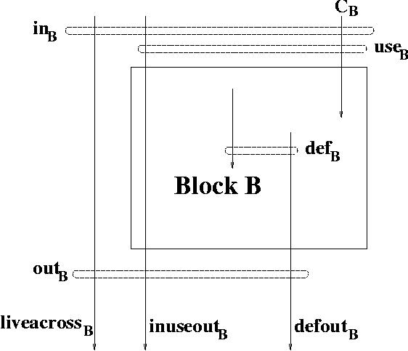
Variable Use Sets Analysis
Total register needs ||liveacross _{B} ^{R}|| + max(||defout _{B}|| + ||inuseout _{B}||, k)
||S|| Cardianility of set S
S ^{R} Subset of S which gets registers

Slide 21
Overheads due to Limited Register Windows
function calls and returns sequence is generated using application instrumentation [Vishal 2002]
Stack based analysis performed to know window spills (Our contribution)
Overhead computation
  Register file configuration (#windows, win. size)
  Processor configurartion

Slide 22
Overheads due to Cache Misses
Observation : Usually the number of memory locations required to store scalar variables and register winodws is small compared to total number of cache locations
Sim-cache from simplescalar tool set used to find memory access profiles
Overhead is computed as
d = α1 + α2 * (b - 1)
α1 : time for first data transfer from memory to cache
α2 : time for each remaining data transfer
b : block size

Slide 23
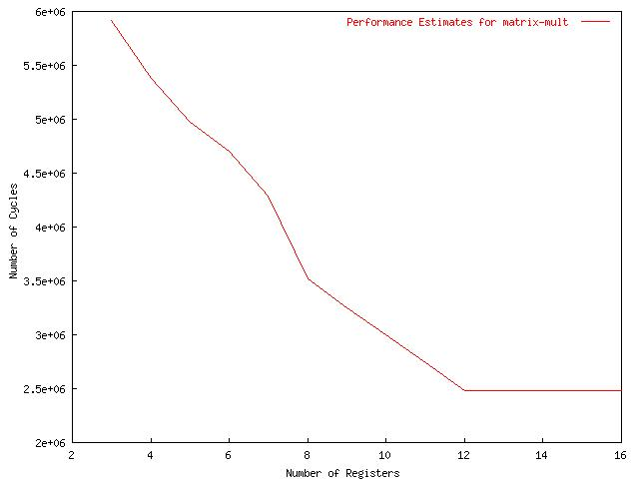
Excution time for matrix-mult with diff. Register file sizes for ARM7TDMI

Slide 24
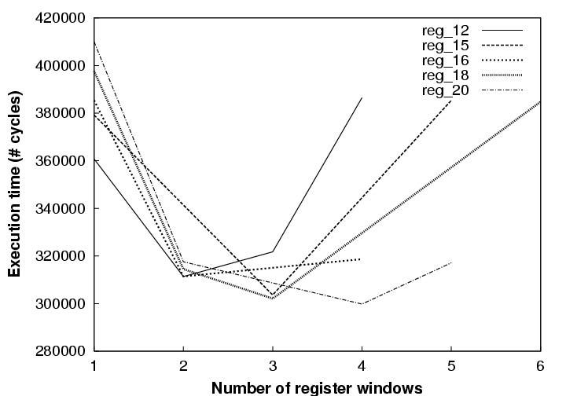
Trade off Number of Register Winodws and Window Size for LEON

Slide 25
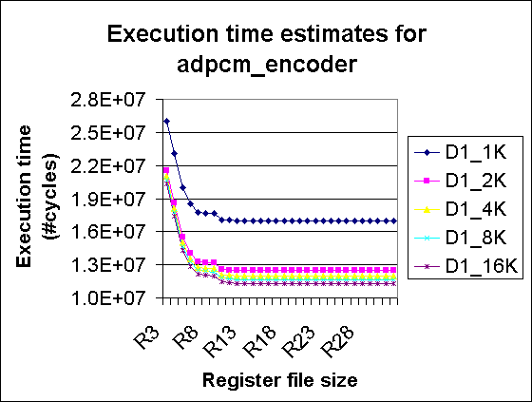
Exploring Reg. File and Cache Size

Slide 26
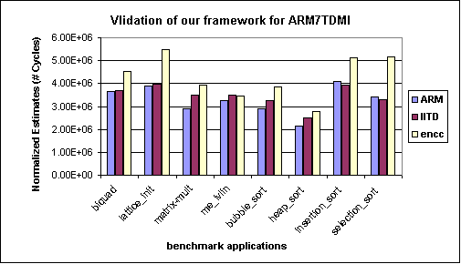
Validation of ASSIST for ARM7TDMI processor

Slide 27
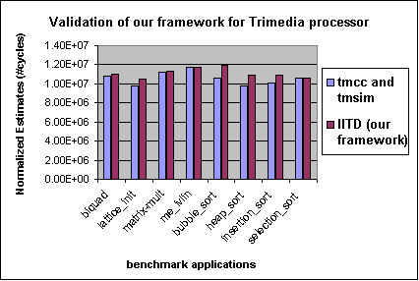
Validation of ASSIST for TM-1000 processor

Slide 28
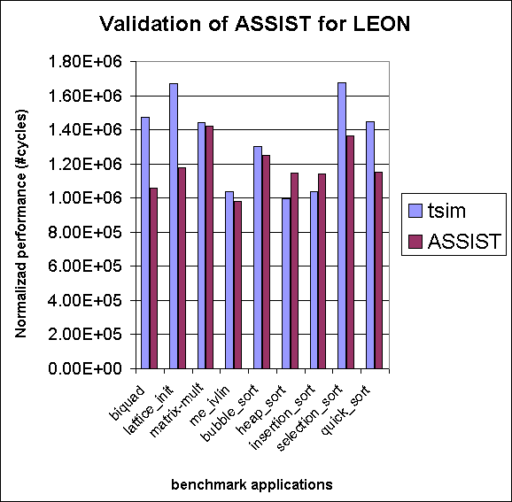
Validation of ASSIST for LEON

Slide 29
Utilization of Proposed Approach
Suitable register file may reduce address bits
  Reduction in instruction width
  Saving in power
  Room of application specific instruction
Other usage of ‘extra’ registers/ reg. addresses
  Simplifying coproc interface
  Use as control/ status register

Slide 30
Simplifying LEON coproc interface
Memory
IU
FPU
Standard Interface

Slide 31
Simplifying LEON coproc interface contd.
Register file
IU
FPU
Proposed Interface

Slide 32
How we do it ?
Reg. address
IU Register Windows
FPU regs.
Globals

Slide 33
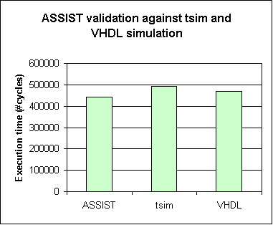
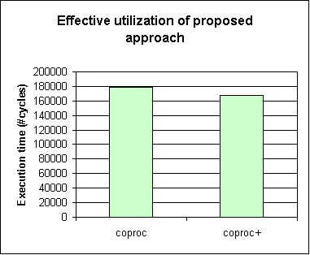
Case study : Collision Detection

Slide 34
Conclusions
Register allocation is performed before scheduling
Consider global needs
Extended to explore register windows and cache configurations
No target specific code generation or simulation
Simple processor description, retargetable
Performance is estimated using a scheduler and profile values
Validated for ARM7TDMI and TM-1000 and LEON processors
Nearly 77 times faster compared to compiler simulator framework

Slide 35
Limitations
Ignored
  Impact of register file size on instruction width
  Change in clock cycle due to processor reconfiguration
  Compiler modifications
Plan to consider in future

Slide 36
Acknowledgements
Prof. M. Balakrishnan and Prof. Anshul Kumar
DST and NRB for sponsorship
Other research scholars in the department

Slide 37
Thanks

Slide 38
Previous work on Storage Exploration
Register banks , I/D-Cache [Gloria90, Gong95, Kin99]
Attempt to optimize register count based on profiler information but method needs code generation and analysis [Honma94]
Language based approach [Mishra2001]

Slide 39
Maximum variation in results
Benchmark Program | Performance |  | Power |  | Energy
 | Reg. size | % inc. | Reg. size | % red. | Reg. size | % red.
biquad_N_sections | 3 → 4 | 57.5 | 3 → 4 | 12.6 | 3 → 4 | 62.9
lattice_init | 4 → 5 | 20.5 | 6 → 7 | 1.0 | 4 → 5 | 21.0
matrix-mult | 3 → 4 | 29.7 | 7 → 8 | 7.4 | 3 → 4 | 33.4
me_ivlin | 3 → 4 | 53.4 | 5 → 6 | 15.3 | 3 → 4 | 59.3
bubble_sort | 4 → 5 | 46.3 | 4 → 5 | 17.3 | 4 → 5 | 55.6
heap_sort | 6 → 7 | 25.6 | 6 → 7 | 10.3 | 6 → 7 | 33.2
insertion_sort | 4 → 5 | 44.8 | 4 → 5 | 22.3 | 4 → 5 | 57.1
election_sort | 3 → 4 | 22.2 | 5 → 6 | 14.0 | 5 → 6 | 30.1
Average |  | 37.5 |  | 12.5 |  | 44.1

Slide 40
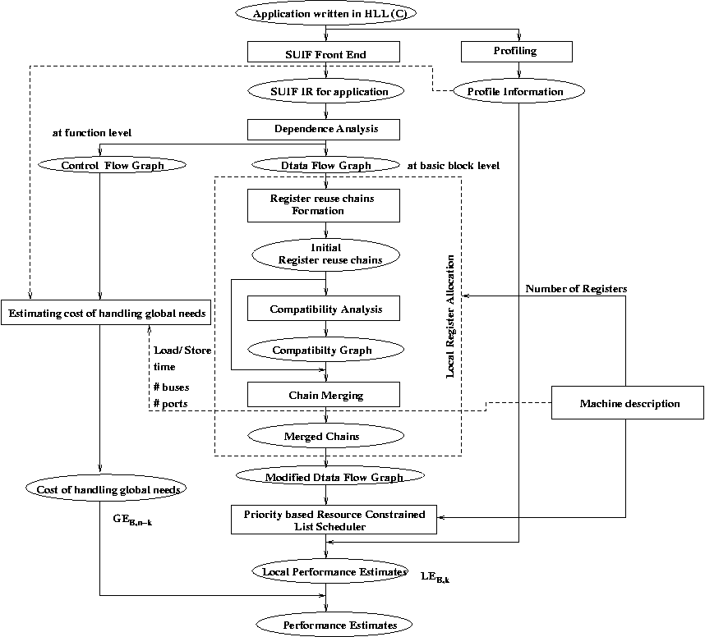

Slide 41
Sample machine description
MACHINE ISSUE SLOTS 1
REGISTERS 16
NUMBER OF PIPELINE STAGES 4
PIPELINE STAGES IF ID EX WB
NUMBER OF WRITE BUSES 1
FU alu
NUMBER 1
OPERATIONS io_ldc 1 io_cpy 1 io_add 1 io_sub 1 io_neg 1 io_not 1 io_and 1 io_ior 1 io_xor 1 io_abs 1 io_cvt 2 io_seq 1 io_sne 1 io_sl 1 io_sle 1 io_min 2 io_max 2 io_abs 2 io_mul 3 io_lod 2 io_str 1 io_memcpy 3 io_asr 2 io_lsl 2 io_lsr 2 io_rot 2 io_btrue 4 io_bfalse 4 io_jmp 3 io_cal 24 io_ret 3 io_lab 1 io_mbr 4 io_seq 2 io_sne 2 io_sl 2 io_sle 2 io_div 3 io_rem 3 io_mod 3 io_divfloor 1 io_divceil 1
SLOTS 1 : 1

